Slide 1
Sales Queue Priority
11/18/2019
Seeth Gudetee - 2019 DS Homegrown

Slide 2
Problem Statement
Current system does not Prioritize High LTV customers
Low LTV customers with less wait times and High LTV customers longer wait times
Resulting in Loss of Conversion and $$$

Slide 3
Objective
Predict
Prioritize
Convert LTV Customers

Slide 4
SEARCH – GOOGLE SEO
Model in Sales Funnel
IVR - PHONE SYSTEMS
SALES QUEUE PRIORTY
MODEL
CONVERSION

Slide 5
APPROACH
Data collection, Features and Preprocessing
ML MODEL – Regression and Random Forest
Analysis
Recommendation
Next Steps

Slide 6

Data Collection - Features – Pre -Processing
Historical Data Volume:
365 days of historical data
657, 697 rows 17 columns
Features:
ZIP
Marketing Program
Marketing Channel
IP geo
User Agent
Data Processing:
Dropped UA Device data
132,249 rows 9 Column
Applied Mean encoding
Normalization : Standard Scalar
Notes:
ZIP (manually entered in IVR - intent indicator)
Marketing Program (e.g. “paid-fr-infr-google-mobile-brand-copper-tp-int”)
Marketing Channel (e.g. “Online Natural Search”, “Online Paid Search”)
IP geo features
User Agent (device) features

Slide 7
EDA - Exploratory Data Analysis
Features
Notes:
ZIP (manually entered in IVR - intent indicator)
Marketing Program (e.g. “paid-fr-infr-google-mobile-brand-copper-tp-int”)
Marketing Channel (e.g. “Online Natural Search”, “Online Paid Search”)
IP geo features
User Agent (device) features

Slide 8
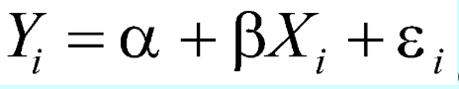
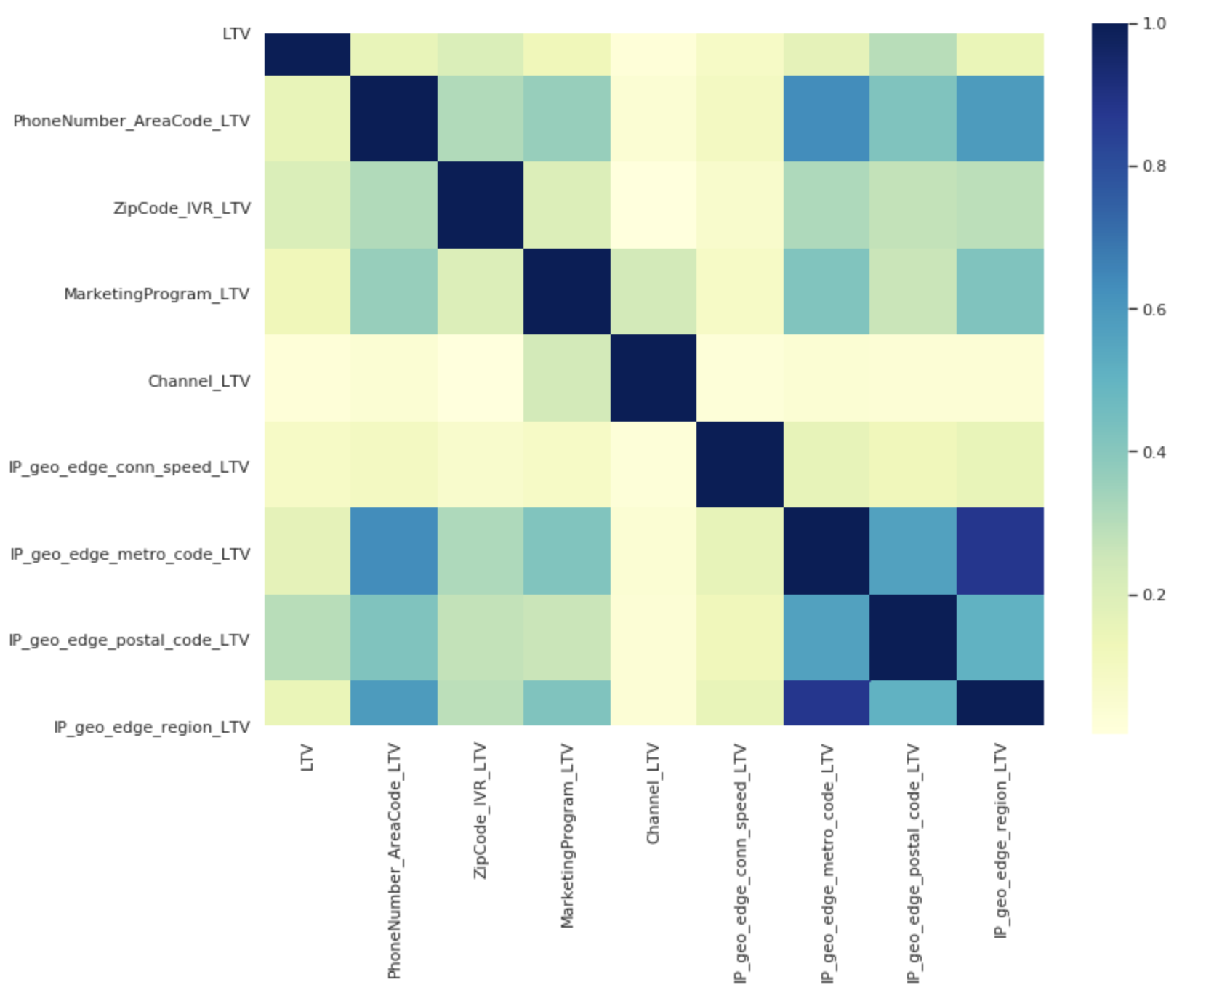
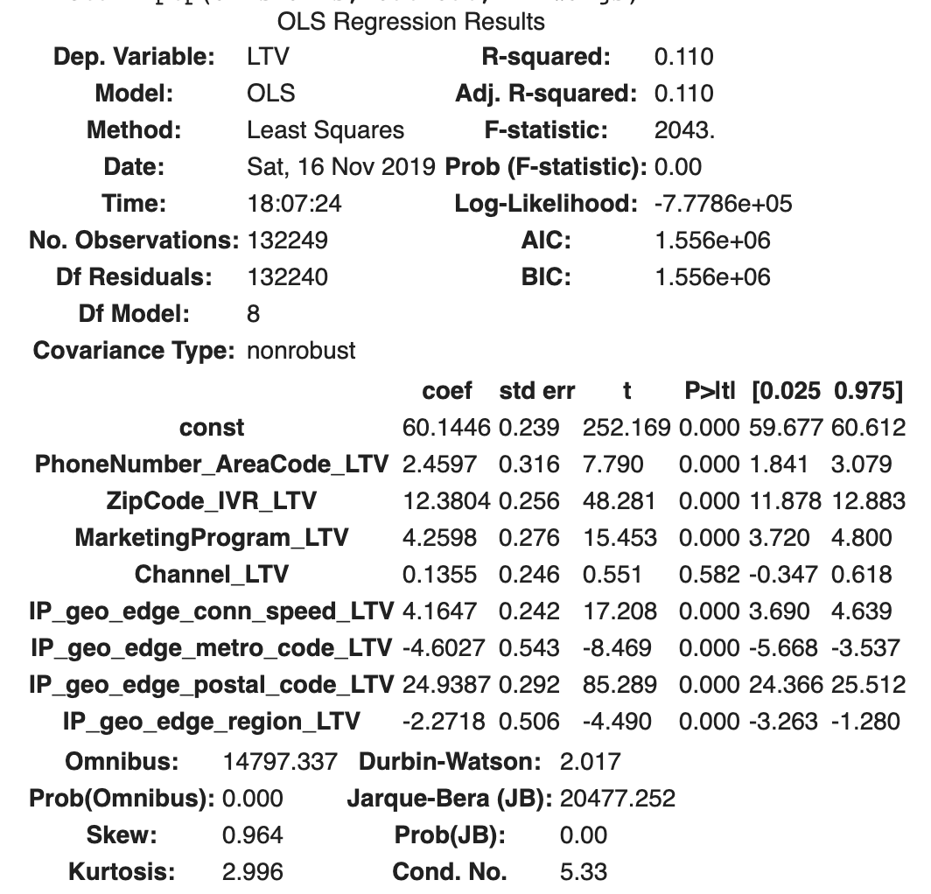
Linear Regression - Analysis
Correlation analysis
- .110 is a Low R2 score. (.2 - .8)
- 9389.39 is High MSE in $$ (0 – Infinity)
MSE = 9389.39
R Square = .110
Notes:
ZIP (manually entered in IVR - intent indicator)
Marketing Program (e.g. “paid-fr-infr-google-mobile-brand-copper-tp-int”)
Marketing Channel (e.g. “Online Natural Search”, “Online Paid Search”)
IP geo features
User Agent (device) features

Slide 9
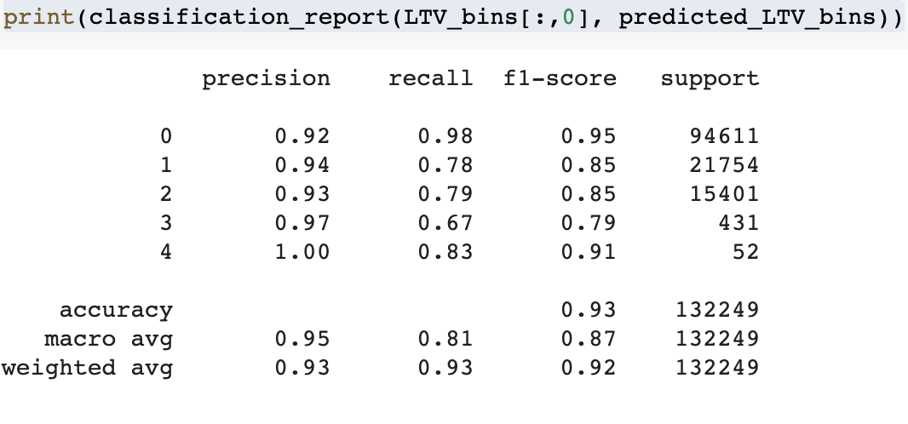
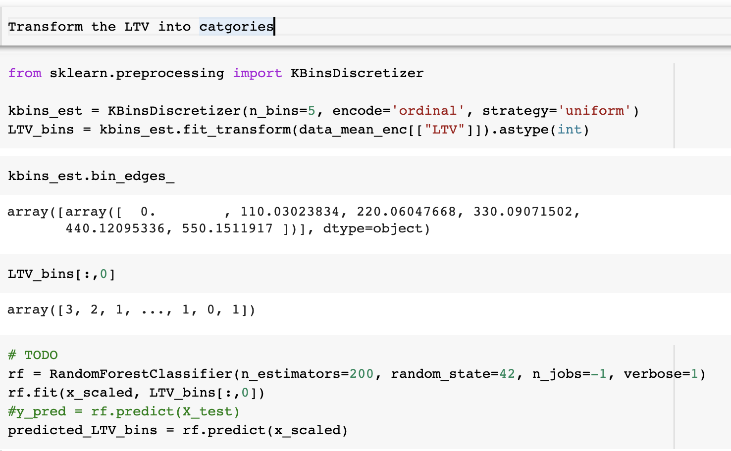
Random Forest
LTV BINS | LTV - Customer Classification
0 - 110.03 | Low
110.04 - 220.06 | Low Medium
220.07- 330.09 | Medium
330.10- 440.12 | Medium High
440.13 - 550.15 | High
Notes:
ZIP (manually entered in IVR - intent indicator)
Marketing Program (e.g. “paid-fr-infr-google-mobile-brand-copper-tp-int”)
Marketing Channel (e.g. “Online Natural Search”, “Online Paid Search”)
IP geo features
User Agent (device) features

Slide 10
Analysis - Conclusion
Confusion Matrix | Hypothesis | Predicted
Actual |  | -VE | +VE
 | -VE | 29953 | 1576
 | +VE | 7685 | 93035
Precision, is greater that 92% which looks good for bin Zero
The High LTV customers have good prediction rate that will lead to high conversion rate and lower call abandonment
Before Normalization
F1 score is the weighted score of Precision and Recall
Precision measure of accuracy of positive prediction/Predicted value
Recall measure of what proportion of actual positives was identified correctly
Notes:
Precision is greater that 92% which looks good is a measure of accuracy of positive prediction is very good

Slide 11
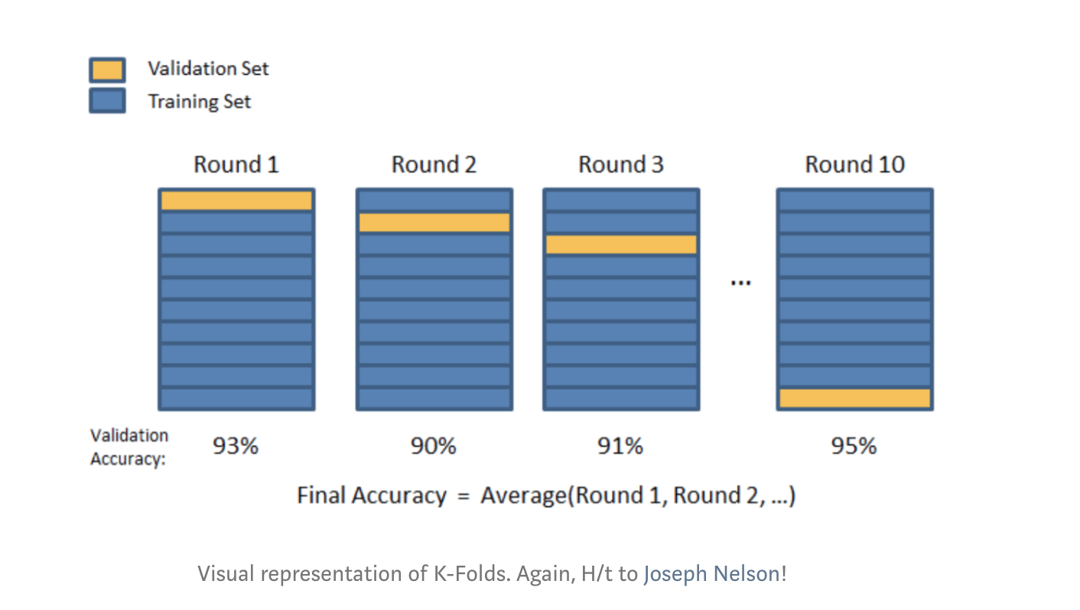
Next Steps
Train and Test Data Split
Identify Optimized Bins
Grid Search CV
Build an ML Integration Pipeline Infra
POC on a Test Environment and Roll it out to Prod

Slide 12
Thank You!

